Slide 1



Intelligent Agent Platform
for Financial New Hire Training
Ultra-Long Text Dynamic Memory Compression & Efficient Q&A System
Notes:
各位好，今天我将为大家展示我们专为金融新员工培训打造的AI智能体平台。这不仅是一个简单的知识库，而是一个集成了超长文本动态记忆压缩和高效问答系统的认知引擎，旨在用AI技术彻底重塑金融行业的培训与合规赋能流程。

Slide 2



Table of Contents
Agenda
01
Project Positioning & Scenarios
02
Core Innovation & Architecture
03
Knowledge Forge & Cognitive Retrieval
04
Technical Breakthroughs & Benchmarks
05
Deployment, Benchmarks & Summary
Notes:
本次汇报将分为五个部分：首先明确项目的业务定位与典型场景；其次剖析核心的创新理念与五层系统架构；接着深入知识锻造与认知检索的底层机制；然后展示我们在动态压缩、推理加速及AMD硬件部署上的技术突破与基准测试；最后进行项目总结与展望。

Slide 3


CHAPTER 01
Project Positioning & Scenarios
Redefining financial onboarding through AI-driven knowledge accumulation and
personalized empowerment
Notes:
让我们先进入第一部分。金融行业的知识密度极高，合规要求严苛，传统的培训方式往往让新员工难以消化。我们来看看这个AI平台是如何定位并解决这些实际业务场景痛点的。

Slide 4

Project Overview
Project Positioning & Core Value
The platform is an AI-driven training ecosystem tailored for the financial
industry, integrating knowledge accumulation, intelligent Q&A, and mock
examinations to accelerate new hires' mastery of complex compliance and
business skills.
01
Full-Workflow Onboarding
Designed specifically for financial onboarding, covering knowledge accumulation to personalized
learning path planning for rapid skill acquisition.
02
AI Technology Synergy
Powered by LLMs, Knowledge Graphs, and RAG to handle dense financial regulations with
precision and depth.
03
Interactive Empowerment
Transforming passive document reading into an interactive, full-process experience that strictly
adheres to compliance requirements.
Modern Enterprise Training Center
Notes:
这个平台的核心定位是一个专为金融行业量身定制的AI智能培训生态系统。大家可以看到，它覆盖了从知识积累到个性化学习路径规划的完整闭环。我们的目标是让新员工快速掌握复杂的合规要求和业务技能。底层依托大模型、知识图谱和RAG技术，将被动阅读转化为主动的认知赋能。

Slide 5

Implementation Scenarios
Typical Implementation Scenarios
Section 01
Section 02
Knowledge Base & Intelligent Q&A
Mock Examination & Course Learning
1
Automatically parses diverse formats (PDF / Word / PPT) to
perform intelligent chunking, vectorization, and knowledge graph
construction for structured data storage.
1
Dynamically generates scenario-based questions and utilizes LLM
semantic scoring to evaluate open-ended answers, automatically
collecting wrong questions for targeted review.
2
Supports natural language inquiries with multi-path retrieval,
delivering precise answers via streaming output while providing full
source tracing for compliance verification.
2
Tracks video course progress and leverages AI to recommend
personalized learning pathways, adapting to each new hire's
unique pace and knowledge gaps.
The platform addresses the full spectrum of financial onboarding needs by automating knowledge ingestion, enabling precise compliance Q&A, and delivering adaptive
examination and learning pathways driven by semantic AI evaluation.
Notes:
在具体落地场景上，我们划分为两大核心模块。左侧是知识库与智能问答，系统能自动解析各类文档并构建图谱，支持带溯源的自然语言问答，这在金融合规审查中至关重要。右侧是模拟考试与课程学习，大模型不仅能动态出题、进行语义评分，还能根据艾宾浩斯记忆曲线安排错题复习，真正实现千人千面的个性化培训。

Slide 6

CHAPTER 02
Core Innovation &
Architecture
Overcoming context limitations with dynamic memory compression and a robust five-
layer system design
Notes:
了解了业务场景，接下来我们进入第二部分，看看支撑这些场景的核心创新理念和整体系统架构。我们是如何突破传统大模型上下文限制的？

Slide 7
Core Innovation: From 'Full-Text Infusion' to 'Cognitive Drawer'
KEY INSIGHT
01 · PROBLEM
Context Window Overflow
Traditional RAG approaches suffer from context window overflow and broken multi-
hop reasoning when processing massive financial documents, leading to severe
information overload.
Transitioning from traditional 'full-text
infusion' to a 'cognitive drawer' model,
the system utilizes a three-tier dynamic
memory compression architecture to
assemble precise micro-contexts,
enabling millisecond-level Q&A over
thousands of pages.
02 · ARCHITECTURE
Three-Tier Compression
Integrates implicit semantic vectors, structured knowledge graph triples, and explicit
dynamic scenario summaries to create a highly efficient 'cognitive drawer.'
03 · RESULT
Dynamic Micro-Context Assembly
Dynamically assembles the most relevant micro-context based on real-time queries,
reducing output token volume by 80% while maintaining strict factual accuracy.
80%
Token output
volume
reduction achieved
ms
Response latency
over thousands of
pages
Notes:
这是我们项目最核心的创新点。传统的RAG方案在处理上千页的金融文档时，经常会遇到上下文溢出和多跳推理断裂的问题。我们提出了'认知抽屉'模型，通过三层动态记忆压缩——隐式向量、结构化图谱和显式场景摘要，根据查询实时组装最相关的微上下文。这不仅解决了信息过载，还实现了千页文档的毫秒级精准问答。

Slide 8
System Design
Overall System Architecture
The platform adopts a robust five-layer architecture that seamlessly integrates responsive frontend interactions,
domain-driven business services, and a hybrid storage infrastructure to support high-concurrency AI inference
and complex data retrieval.
Layer 01
Layer 02
Layer 03
Frontend & Gateway
Business & AI Layers
Infrastructure Foundation
Built with React/TypeScript and FastAPI,
supporting SSE streaming output and
unified authentication to ensure a
responsive, secure user experience.
Domain-Driven Design (DDD) modules
handle core workflows, backed by a local
vLLM (Qwen3-14B-AWQ) inference
engine with cloud failover for high
availability.
Utilizes a hybrid storage strategy
combining MySQL for relational data,
zvec for high-dimensional vectors, Neo4j
for graph triples, and DiskCache for rapid
access.
Notes:
在整体架构上，我们采用了严谨的五层设计。前端和网关层使用React和FastAPI，确保SSE流式输出的低延迟与高并发安全。业务与AI层采用DDD领域驱动设计，核心推理引擎基于本地部署的Qwen3-14B模型，并配备云端容灾。底层基础设施则创新性地融合了关系型数据库、向量库zvec和图数据库Neo4j，为复杂金融数据提供混合存储支撑。

Slide 9
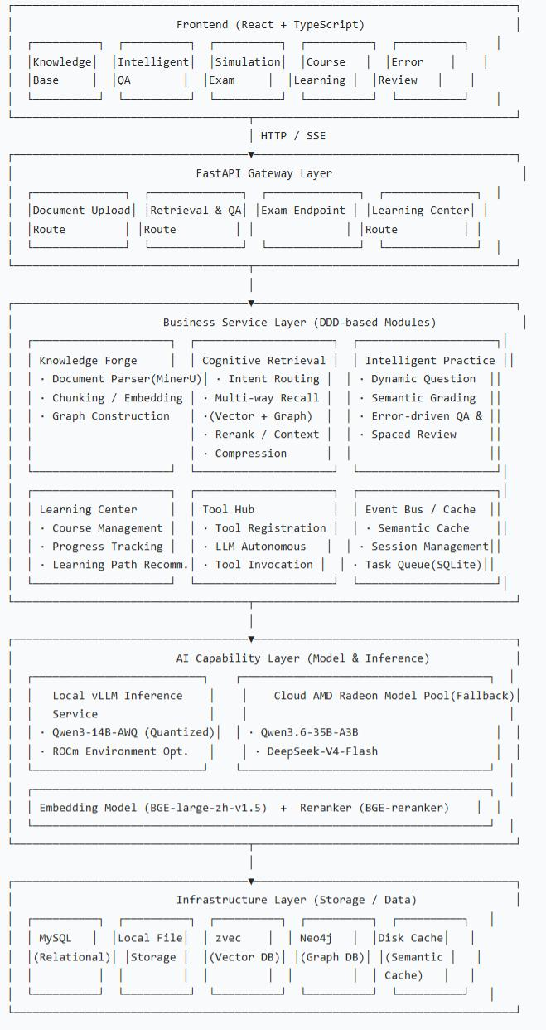
System Design
Notes:
在整体架构上，我们采用了严谨的五层设计。前端和网关层使用React和FastAPI，确保SSE流式输出的低延迟与高并发安全。业务与AI层采用DDD领域驱动设计，核心推理引擎基于本地部署的Qwen3-14B模型，并配备云端容灾。底层基础设施则创新性地融合了关系型数据库、向量库zvec和图数据库Neo4j，为复杂金融数据提供混合存储支撑。

Slide 10
CHAPTER 03
Knowledge Forge & Cognitive
Retrieval
Industrial-grade document parsing, graph construction, and adaptive multi-path
retrieval mechanisms
Notes:
架构搭建好后，数据是如何流转的？第三部分我们将深入剖析知识锻造工坊和认知检索机制的底层工作流。

Slide 11


Module 03 · Knowledge Forge
Deep Dive into Knowledge Forge Workflow
The Knowledge Forge module transforms unstructured financial documents into a highly structured, query-ready hybrid database through industrial-grade parsing, semantic-
preserving chunking, and automated knowledge graph construction.
01
Leverages MinerU SDK to extract text, tables, and formulas from complex PDFs and images, ensuring no critical financial data is
lost during ingestion.
Industrial-Grade
Parsing
02
Intelligent
Chunking &
Vectorization
Recursively splits documents based on Markdown headings (512 Tokens per chunk) to preserve semantic integrity, then generates
1024-dimensional vectors via BGE-large-zh.
03
Graph
Construction &
Async
Processing
LLM extracts complex entity-relation triples (e.g., compensation rules impacting bancassurance) into Neo4j, while background
queues handle heavy tasks without blocking the UI.
Pipeline Flow
Notes:
知识锻造工坊是整个系统的数据源头。我们使用MinerU SDK进行工业级解析，不仅能提取文本，还能精准识别复杂的金融表格和公式。在分块策略上，我们按Markdown标题递归切分，保证512 Token内的语义完整。随后，大模型会提取诸如'薪酬规则影响银保佣金'这样的实体关系写入Neo4j图谱。所有重计算任务均在后台异步队列处理，绝不阻塞前端交互。

Slide 12

Mechanism Overview
Cognitive Retrieval Mechanism
01
Adaptive Routing & Parallel Search
Dynamically selects vector, graph, or hybrid retrieval based on query intent, executing concurrent searches via asyncio to minimize latency.
Re-ranking & Compression
02
Employs BGE-reranker to filter Top-5 candidates, followed by LLM semantic distillation that truncates context and achieves a compression
ratio of up to 1/5.
Semantic Caching
03
Instantly returns cached responses for queries with a similarity score above 0.92, dropping latency to under 50ms for frequently asked
compliance questions.
Key Insight
By combining adaptive routing, parallel multi-path retrieval, and aggressive semantic distillation, the cognitive retrieval engine guarantees high-precision
answers with sub-50ms latency for frequent financial compliance queries.
Notes:
有了高质量的数据，检索机制必须足够聪明。我们的认知检索引擎具备自适应路由能力，能根据查询意图自动选择向量、图谱或混合检索，并通过异步并发执行。最关键的是重排与压缩环节，BGE-reranker筛选出Top-5后，大模型会进行语义蒸馏，将上下文压缩至原来的五分之一。配合相似度大于0.92的语义缓存，高频合规问题的响应延迟被压缩到了50毫秒以内。

Slide 13

Core Platform Modules
Intelligent Practice & Learning Center
The platform closes the training loop by combining LLM-driven semantic grading with spaced repetition algorithms, while dynamically adapting learning
pathways based on individual performance and knowledge retention metrics.
Module 01
Module 02
Intelligent Practice Engine
Personalized Learning Center
01
Generates scenario-based and step-by-step questions from
knowledge fragments, using LLM semantic grading to evaluate
correctness against reference answers.
01
Manages video course uploads and tracks granular progress
metrics, including playback percentage and last-watched
position, to maintain learning continuity.
02
Implements the SM-2 spaced repetition algorithm to
dynamically schedule wrong-question reviews, optimizing long-
term memory retention for critical financial protocols.
02
Analyzes individual completion status and examination
performance to recommend subsequent courses, providing
clear rationales for each personalized pathway adjustment.
Notes:
在培训闭环的后半段，智能练习与学习中心发挥了关键作用。左侧的练习引擎能从知识片段中动态生成场景题，并用大模型进行语义维度的评分，结合SM-2算法科学安排错题复习。右侧的学习中心则追踪视频进度，分析个人的考试表现，由AI动态推荐后续课程并给出推荐理由，彻底告别一刀切的培训模式。

Slide 14


Chapter 04
Technical Breakthroughs &
Optimization
Code-level memory compression, multi-level acceleration, and deep hardware inference tuning
Notes:
第四部分，我们将进入本次汇报最硬核的技术深水区。大家将看到我们是如何在代码层面实现三层动态压缩，以及如何榨干AMD GPU的推理性能的。

Slide 15



Three-Tier Dynamic Memory Compression Architecture
TIER
Atomized Chunks
01
Preserves heading hierarchies with 512-token chunks and 64-token overlaps, retaining crucial metadata like page numbers and source
documents for auditability.
TIER
Implicit & Structured Memory
02
Dual-database approach where zvec stores semantic vectors for broad similarity matching, while Neo4j maps precise entity-relation triples for
multi-hop reasoning.
TIER
Working Memory Compressor
03
Dynamically truncates context (max 1500 chars, top 20 nodes) and distills multiple segments into core knowledge points, reducing payload size
by 80%.
The three-tier architecture systematically reduces context volume by combining atomized semantic chunks, dual-
database structural mapping, and real-time LLM distillation, ensuring high-fidelity reasoning within strict token limits.
Notes:
详细拆解我们的三层动态压缩架构。第一层是原子化语义块，保留标题层级和元数据，确保溯源能力。第二层是隐式与结构化记忆的双库协同，zvec负责广度匹配，Neo4j负责深度多跳推理。第三层是动态工作记忆压缩器，它会在实时查询时，将上下文硬截断并调用大模型蒸馏成核心知识点，直接将输入给大模型的Payload体积压缩了80%。

Slide 16
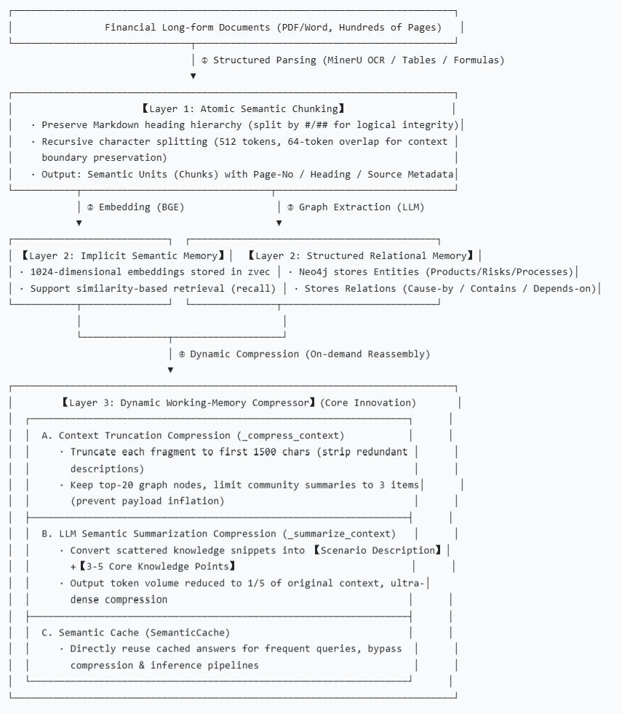
Three-Tier Dynamic Memory Compression Architecture
Notes:
详细拆解我们的三层动态压缩架构。第一层是原子化语义块，保留标题层级和元数据，确保溯源能力。第二层是隐式与结构化记忆的双库协同，zvec负责广度匹配，Neo4j负责深度多跳推理。第三层是动态工作记忆压缩器，它会在实时查询时，将上下文硬截断并调用大模型蒸馏成核心知识点，直接将输入给大模型的Payload体积压缩了80%。

Slide 17
Code-Level Analysis of Compression Mechanism
By implementing dual-phase compression strategies at both the data ingestion (write-time) and inference (read-time) stages, the system eliminates context-
window bottlenecks and maintains lean database structures for peak concurrency.
Phase 01
Phase 02
Result
Read-Time Compression
Write-Time Compression
Synergistic Effect
On-the-Fly
Compress-on-Write
Dual-Phase Synergy
Enforces hard truncation limits (1500 chars per
fragment, 20 graph nodes, 3 community
summaries) and invokes LLM distillation only
when text exceeds 800 characters.
Applies fine-grained 512-token chunking during
ingestion and compresses full-length
documents into highly structured entity-relation-
entity triples for the graph database.
This dual-phase approach ensures that the
database remains lean and highly structured,
while real-time inference avoids context-window
bottlenecks during peak concurrent usage.
Inference Stage
Ingestion Stage
System Output
Notes:
在代码实现层面，我们设计了读时和写时的双重压缩策略。写时压缩发生在数据入库阶段，通过细粒度分块和图谱三元组提取，让数据库保持极度精简。读时压缩则是On-the-Fly的，当检索片段超过800字符时，系统会自动触发大模型蒸馏，并严格限制图节点和社区摘要的数量。这种双管齐下的策略，彻底消除了高峰期并发推理时的上下文瓶颈。

Slide 18

Multi-Level Q&A Acceleration Mechanism
Ultimate performance optimization is achieved through concurrent hybrid retrieval, aggressive context filtering
that reduces token volume by 99.9%, and streaming architectures that guarantee minimal time-to-first-token.
Phase 01
Phase 02
Phase 03
Parallel Hybrid
Retrieval
Aggressive Filtering
Streaming & Caching
BGE-Reranker strictly limits context to
Top-5 candidates, reducing input token
volume by 99.9% and preventing LLM
hallucination from irrelevant noise.
Server-Sent Events (SSE) enable
incremental token display for low time-to-
first-token, while semantic caching
guarantees sub-50ms responses for
repeated queries.
Leverages high GPU parallelism to
execute vector and graph searches
concurrently, drastically reducing the
initial data gathering phase.
GPU-Parallel Execution
99.9% Token Reduction
SSE + Semantic Cache
Notes:
除了压缩，我们在问答加速上也做到了极致。首先是利用GPU高并行度进行向量与图谱的并发检索。其次是激进的过滤策略，BGE-Reranker将上下文Token量削减了99.9%，这不仅加快了速度，更大幅降低了模型幻觉。最后，SSE流式输出和语义缓存的结合，确保了用户端极低的字首延迟和重复问题的瞬时响应。

Slide 19

CHAPTER 05
Deployment, Benchmarks &
Summary
Hardware-level inference tuning, quantitative performance validation, and strategic
project outlook
Notes:
最后一部分，我们来看看这套系统在国产/AMD硬件上的部署表现，以及与传统方案的量化对比，最后进行项目总结。

Slide 20

Technical Architecture
Model Selection & AMD ROCm
Inference Optimization
Model Selection
Qwen3-14B-AWQ (4-bit quantization) requires only ~10GB VRAM for 16k context windows, supported by BGE-large-zh for SOTA Chinese embedding and AMD Cloud API for failover.
ROCm Deep Optimization
Tunes environment variables (e.g., HIP_FORCE_DEV_KERNARG) and vLLM parameters (AWQ, prefix caching, 0.85 memory utilization) to maximize AMD
Radeon GPU throughput.
Performance Metrics
Achieves a time-to-first-token of ~200ms and generation speeds of 30–40 tokens/s, ensuring end-to-end latency remains between 3–5 seconds for complex
financial reasoning.
Key Insight — By strategically selecting the Qwen3-14B-AWQ model and deeply optimizing it for AMD Radeon GPUs via ROCm, the system achieves high-performance local
inference with minimal VRAM consumption and robust failover mechanisms.
Notes:
在部署方案上，我们选择了Qwen3-14B-AWQ模型，4-bit量化仅需10GB显存即可支撑16k上下文，性价比极高。更关键的是，我们针对AMD Radeon GPU和ROCm环境进行了深度调优，包括环境变量注入、vLLM参数微调以及前缀缓存的开启。最终实测数据显示，首字延迟约200ms，生成速度达到30-40 tokens/s，端到端延迟控制在3到5秒内，完全满足企业级生产要求。

Slide 21
Quantitative Value & Performance Benchmark Comparison
Benchmark tests demonstrate that the proposed dynamic compression and RAG architecture drastically
outperforms traditional brute-force truncation methods across all critical metrics, including processing limits,
reasoning accuracy, and response latency.
System Performance vs. Traditional Brute-Force Truncation
Evaluation Metric | Traditional Scheme | Proposed System (Dynamic Compression)
Maximum Single Document Processing Limit | <8k tokens (~10 pages) | Unbounded (Dynamic Chunking + Knowledge Graph)
Context Redundancy Rate | Extremely High (Massive Irrelevant Content) | <5% (Only Relevant Chunks Retrieved)
Multi-Hop Reasoning Accuracy | Low (Broken Logical Chains) | +40% Improvement (Graph Complementation)
Average Output Token Count | 4000+ Tokens | <1500 Tokens (After Compression)
Latency for Frequent Queries | 3~5 Seconds | <50ms (Semantic Cache Hit)
Notes:
这张表格量化了我们系统的颠覆性优势。传统方案处理超过10页的文档就会崩溃，且上下文冗余率极高。而我们的动态压缩+RAG方案，不仅打破了文档长度限制，将上下文冗余率降至5%以下，更通过图谱补全将多跳推理准确率提升了40%。平均输出Token量大幅缩减，高频查询延迟更是从秒级跨越到了50毫秒以内。

Slide 22
Strategic Summary
Project Summary & Strategic Outlook
The project transcends basic document search by delivering an end-to-end, cost-effective, and highly scalable
AI training ecosystem, specifically engineered to handle the extreme complexity and compliance requirements
of the financial industry.
Beyond Simple Search
End-to-End Empowerment
Scalable & Cost-Effective
Evolves past basic 'document search + LLM'
into a dynamic memory compression system
specifically engineered for ultra-long,
knowledge-intensive financial texts.
Seamlessly integrates knowledge
management, cognitive Q&A, semantic
examination, and personalized learning into a
single, cohesive onboarding ecosystem.
The modular DDD architecture and efficient
single-GPU local inference (with cloud
backup) provide a highly scalable, cost-
effective blueprint for enterprise AI
deployment.
Notes:
最后总结一下。这个项目绝不仅仅是'文档搜索+大模型'的简单拼接，而是一个专为金融超长文本打造的动态记忆压缩与高效问答系统。它实现了从知识管理到考试赋能的端到端闭环，并通过原子化分块、双库检索和极致的硬件调优，在单张GPU上跑出了企业级的性能。模块化的DDD架构也为其未来的横向扩展奠定了坚实基础。

Slide 23

Thank You
We Welcome Communication & Cooperation
Notes:
以上就是本次汇报的全部内容。我们非常期待能与各位在金融AI落地应用方面有更多的交流与合作。感谢大家的聆听，欢迎提问！

